Slide 1
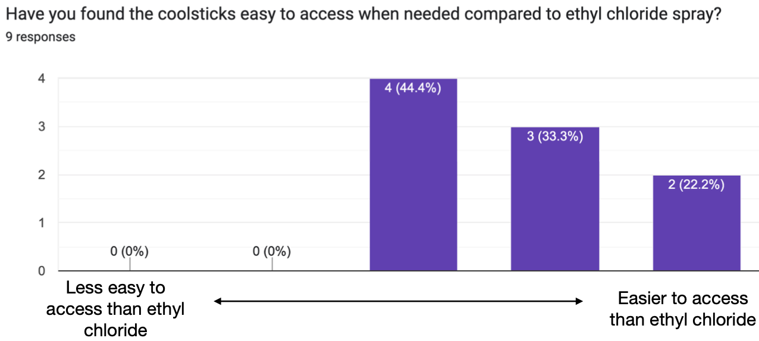
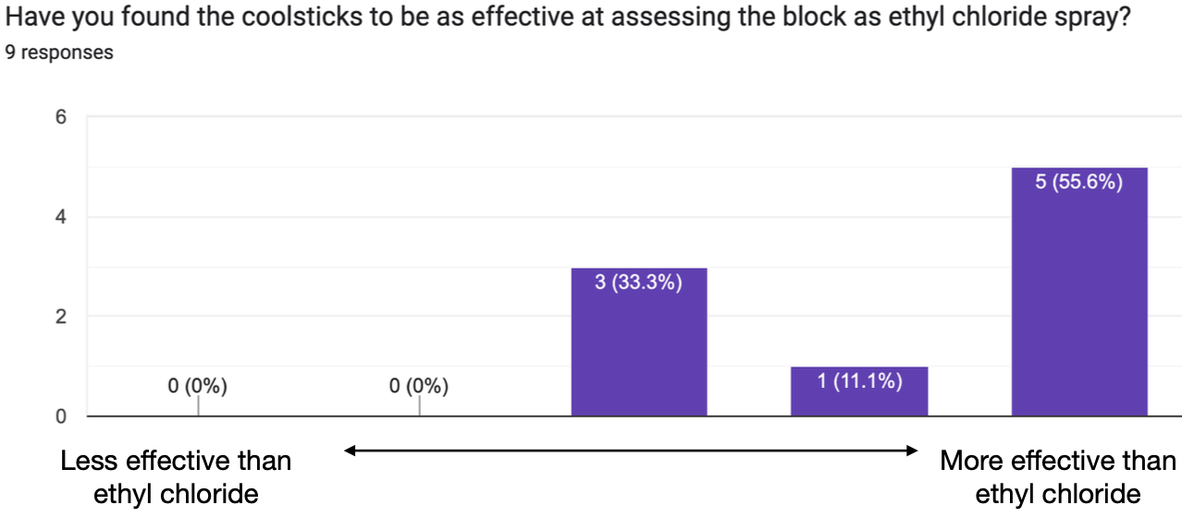
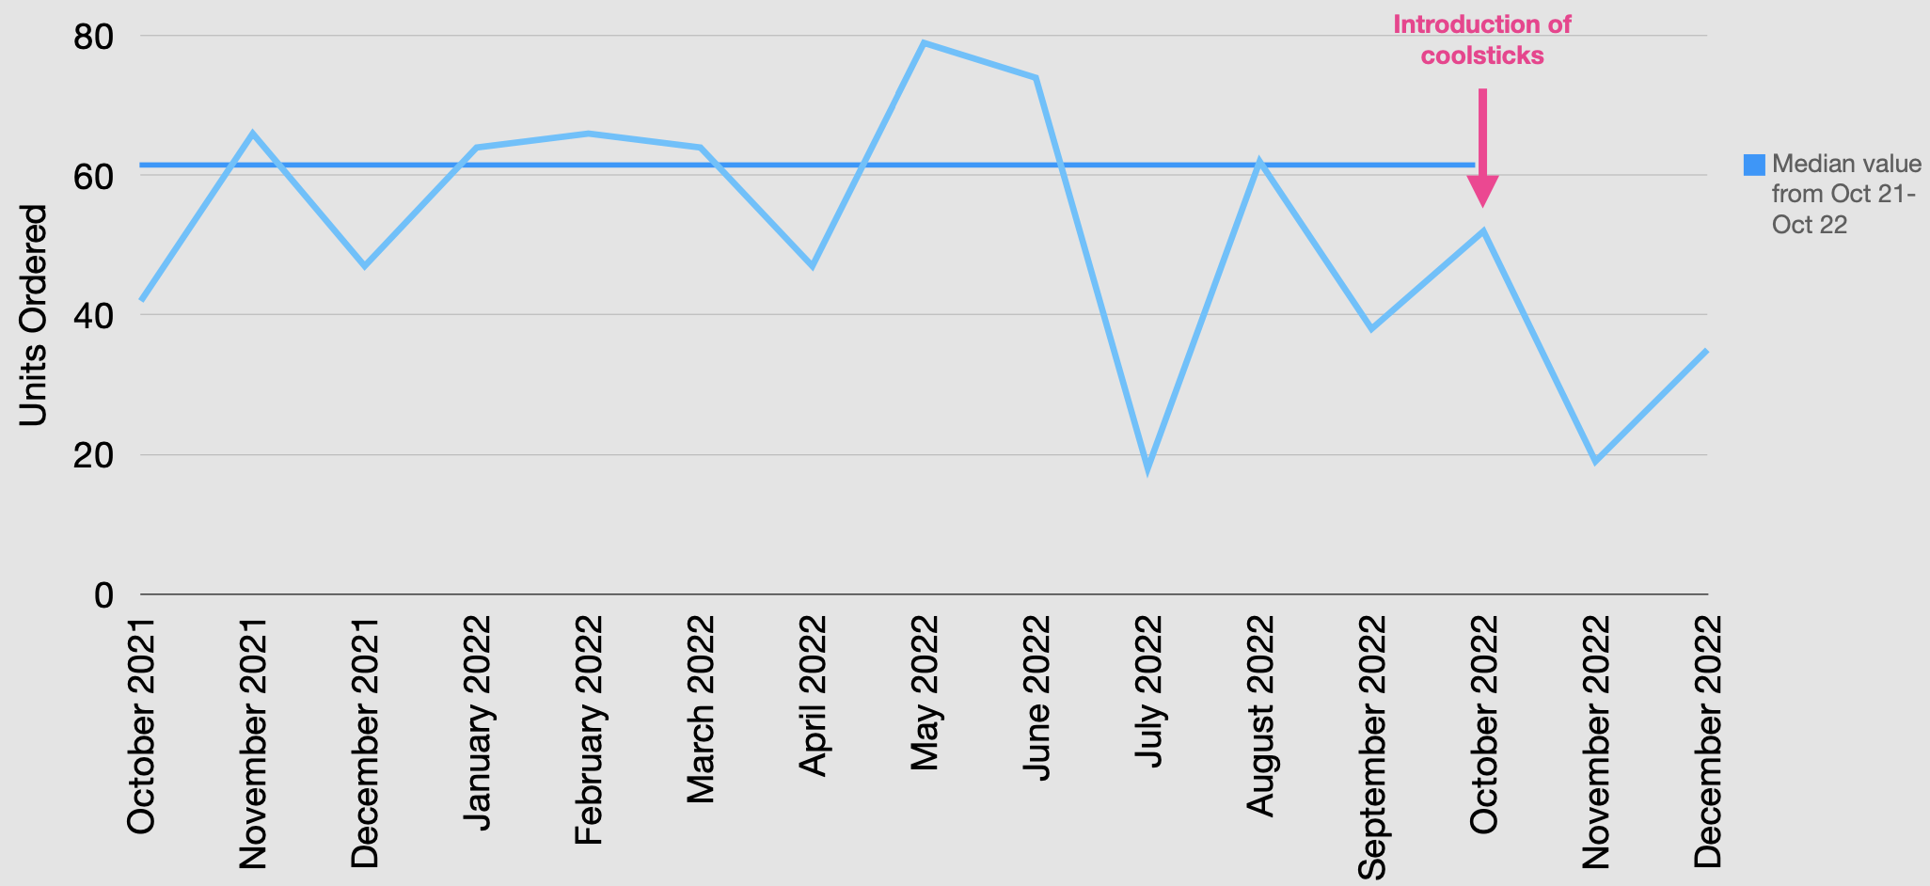
Reducing Ethyl Chloride Usage with Innovative Cool Sticks
Dr. M N Arsanious Dr. H Nugent Dr. D Rafia Dr. C Papoutsos Dr. C McCabe
Newham General Hospital Barts Health NHS Trust
Background
Methodology
Over 90% of UK caesarian sections are done with neuro-axial blockade (1). Until recently the main ways of testing the level of neuro-axial blockade in anaesthesia has been through
10 cool sticks were obtained from the supplier along with contact details of other anaesthetic departments currently using the equipment.
This helped define our initial trial target (elective & emergency obstetric theatres not including labour ward) as well as our key secondary indicators:
Acceptability & Ease of use for the block level assessors
Effectiveness of block level discrimination compared to ethyl chloride
Cool Sticks were then demonstrated to the anaesthetic and theatre staff for a trial period of 3 months:
Ethyl Chloride usage was monitored
Staff were surveyed at the end of this period
This QIP received trust ethic committee approval
checking the modalities of coarse touch with a neuro-tip or more prevalently using ethyl chloride to assess temperature.
Ethyl Chloride is an aerosolised spray of chloroethane (chemical formula C2H5Cl) which is both costly and harmful to the environment generally not to mention the carbon foot print produced in its manufacture and transportation.
Figure 2 a & b: survey results of secondary indicators
An innovative new piece of equipment called ‘cool sticks’ piloted by a group in Bournmouth for the OAA 2020 Green ward competition, achieves similar levels of discrimination when assessing the level of neuro-axial blockade with several advantages over the traditional ethyl chloride.
Results
Conclusions
Figure 1: Ethyl Chloride Usage by units
Median ethyl chloride purchasing over the 3-month trial period dropped from 62 units / month to 35 unit / month – longer term data collection will confirm these findings.
Anaesthetists are happy and mostly prefer the cool sticks for assessing block levels
We aim to translate this new practice to labour ward and other hospitals within the trust
Withdrawn from the fridge the cool stick is cold enough to be used for block level testing and stays cold for 15 mins. Once used for one patient it can be cleaned with a disinfectant wipe and returned to the fridge for the next patient.
Aim:
To reduce ethyl chloride usage in obstetric theatres by 50% in 3 months
References
(1) Bamber, J.H., Lucas, D.N., Plaat, F., Russell, R., 2020. Obstetric anaesthetic practice in the UK: a descriptive analysis of the National Obstetric Anaesthetic Database 2009-14. Br. J. Anaesth. 125, 580–587.

